Slide 1
Lab 1 (Distributed System)
Rajib Chandra Das Sarker Miraz Mahfuz

Slide 2
Design Concept
Action | URI | Explanation | Parameters | API For
GET | / | Display index page |  | Clients
GET | /board | Display contents |  | Clients
POST | /board | Add new Entry | Entry | Clients
POST | /board/<number:int> | Modifying and Deleting entry | ID, Entry, Option | Clients
POST | /propagate | Propagating add request | Entry | Server
POST | /propagate_deletemodify | Propagating delete or modify request | ID, Entry, Option | Server
GET | /board/alldata | Getting all blackboard contents as JSON |  | Script
GET | /serverlist | Getting list of servers |  | Script

Slide 3
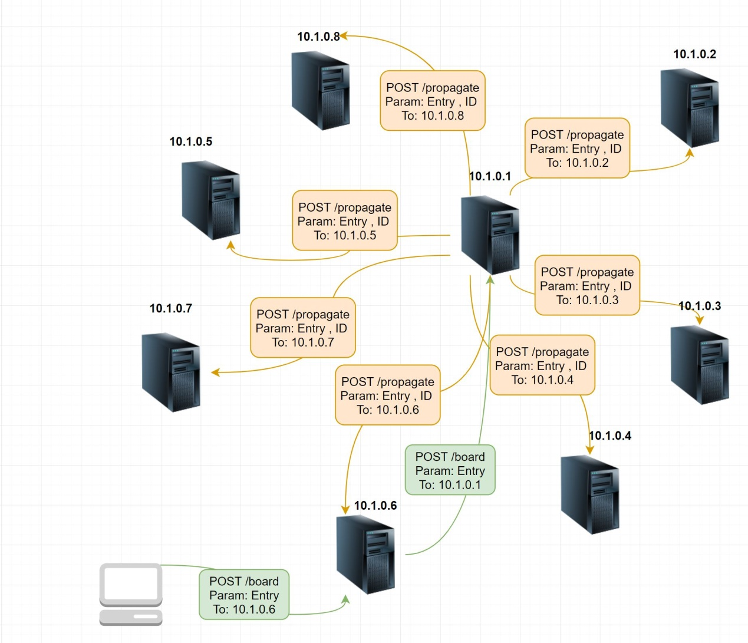

Slide 4
Complexity
If we have N servers, we need to send N requests for each operations (add/modify/delete).
We are using python Dictionary data structure as storage for black board contents.
Operation | Average Case | Amortized Worst Case
Copy[2] | O(n) | O(n)
Get Item | O(1) | O(n)
Set Item[1] | O(1) | O(n)
Delete Item | O(1) | O(n)
Iteration[2] | O(n) | O(n)

Slide 5
Advantages
Data is Consistent.
Handle requests Concurrently.
Using Threadpool rather than spawning threads for concurrent requests.
Imposing delay rather than crashing for massive requests.

Slide 6
Limitation
Not Scalable. Leader server handles all (add/modify/delete) requests.
Not Fault tolerant. System fails when leader server is not available.
Not Dynamic. System can’t detect new Server.

